Slide 1


RESTful Services LAB

Slide 2
Overview
CLIENT
HTTP
SERVER
Representational State Transfer

Slide 3
Overview
Create
Read
SERVER
Update
Delete
CRUD Operations

Slide 4
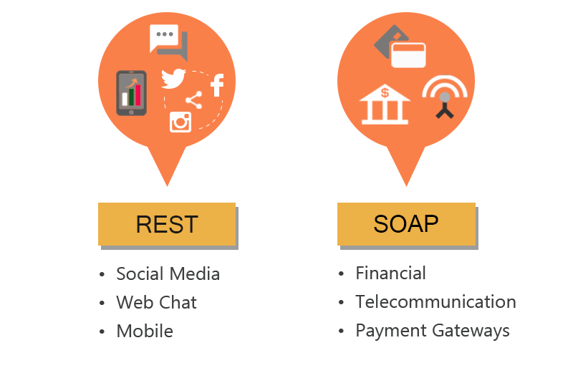
REST vs SOAP

Slide 5










Project
Customers
Products
Sales
Discounts

Slide 6
Project
Customers
http://stored.com/api/customers
Products
http://stored.com/api/products
resource
Sales
http://stored.com/api/sales
http://stored.com
Discounts
http://stored.com/api/discounts
http://api.stored.com

Slide 7
Project
HTTP METHODS
Get Customers
GET
Request
GET
/api/customers
POST
Response
[
{ id: 1, name: ‘Hugo’},
{ id: 2, name: ‘Kim’},
…
]
PUT
Delete

Slide 8
Project
HTTP METHODS
Get a Customer
GET
Request
GET
/api/customers/1
POST
Response
{ id: 1, name: ‘Hugo’}
PUT
Delete

Slide 9
Project
HTTP METHODS
Create a Customer
GET
Request
POST
/api/customers
{ name: ‘Kim’}
POST
PUT
Response
{ id: 1, name: ‘Kim’}
Delete

Slide 10
Project
HTTP METHODS
Update a Customer
GET
Request
PUT
/api/customers/1
{ name: ‘Fernando’}
POST
PUT
Response
{ id: 1, name: ‘Fernando’}
Delete

Slide 11
Project
HTTP METHODS
Delete a Customer
GET
Request
DELETE
/api/customers/1
POST
Response
PUT
{ id: 1, name: ‘Fernando’}
DELETE

Slide 12
Project
HTTP METHODS
GET /api/customers
GET
GET /api/customers/1
POST
POST /api/customers
PUT
PUT /api/customers/1
DELETE
DELETE /api/customers/1

Slide 13
Project
1
Setup Project
5
HTTP POST Request
Build Web Server
HTTP Delete Request
2
6
3
Route Parameters
7
HTTP PUT Request
4
HTTP Get Request
8
Calling Endpoints - Postman

Slide 14
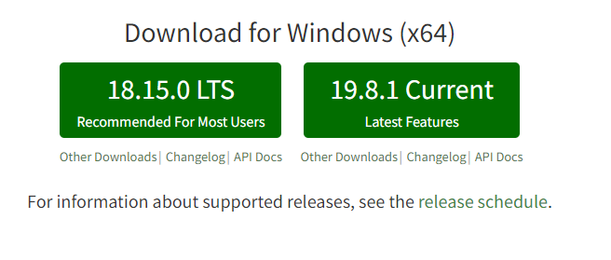
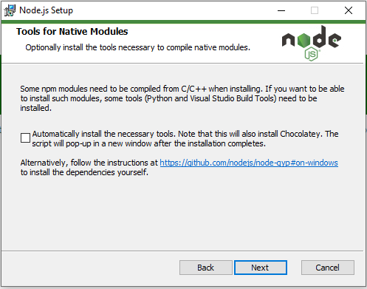
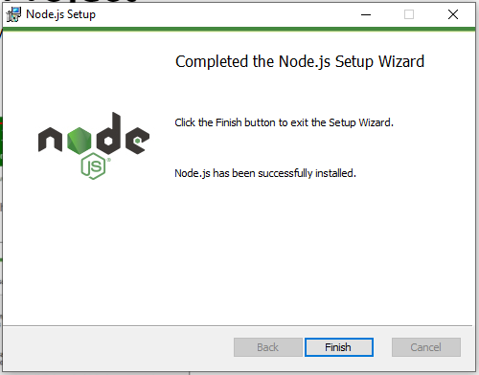
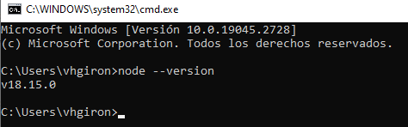
Setup Project
Node JS : JavaScript runtime built on Chrome's V8 JavaScript engine.
https://nodejs.org/en/
Verify Installation:
CMD
node --version

Slide 15

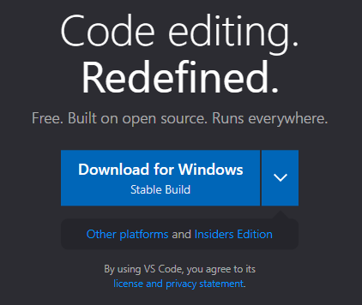
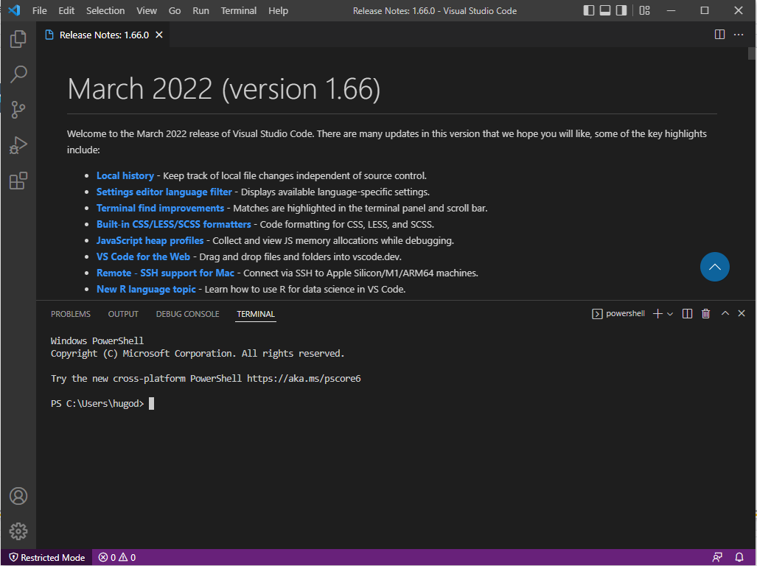
Setup Project
Visual Studio Code : Code editor redefined and optimized for building and debugging modern web and cloud applications
https://code.visualstudio.com/

Slide 16

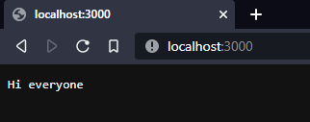
Setup Project
https://www.npmjs.com/
Make a folder, that contains our project.
Init NPM, inside our project folder
npm init –yes
Create file app.js
Execute command:
node app.js
const http = require('http'); //Constant to use http for create our server
const server = http.createServer((req,res) => //Request, Respond at the moment of the creation of the server
{
if(req.url =='/'){
res.write('Hi everyone');
res.end();
}
});
server.listen(3000); //Port where we're going to login to the server
console.log('Listening on port 3000........');

Slide 17
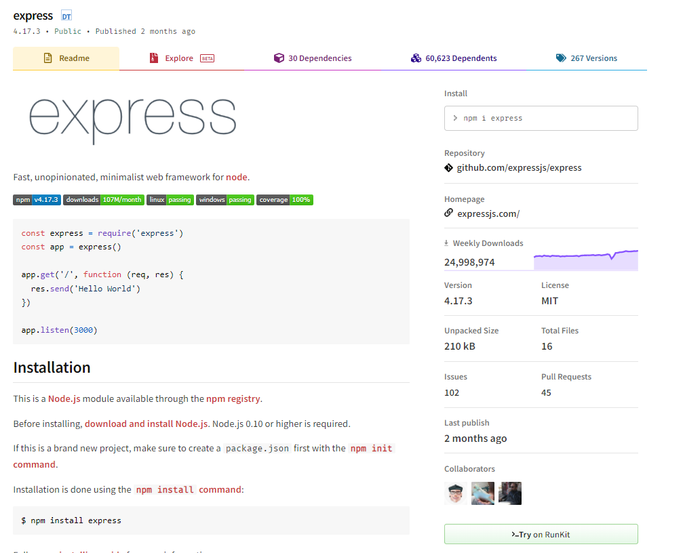
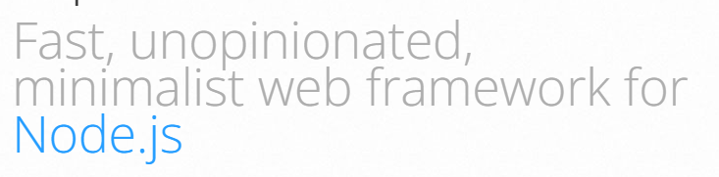
Setup Project
Framework : Allow us to structure our application to easily add new functionalities.
https://www.npmjs.com/package/express
https://expressjs.com/

Slide 18
Build Web Server
//Using Express framework
const express = require('express')
const app = express();
//Array of customers to be consumed
const customers = [{"id":1,"name":"Benjamin"}
,{"id":2,"name":"Victor"},{"id":3,"name":"Cristhian"}];
//Build the Get Method setting the uri that we're going to use
//This is going to return all the customers on our array
app.get('/api/customers',(req,res)=>{
res.send(customers);
})
//Start our service
app.listen(3000, ()=> console.log('Listening on port 3000...'))
In terminal
npm install express
Create file index.js
Execute command:
node index.js
Post Fix
//Build and empty URI get method as our welcome page
app.get('/',(req,res)=>{
res.send("Welcome Class");
})

Slide 19
HTTP Get Request
4
GET /api/customers
GET /api/customers/1
//Build the Get Method with an identifier
app.get('/api/customers/:id',(req,res)=>{
//create constant customer that is going to use a find function
//We are going to parse the id to this to try to match the id that we have on the array
const customer = customers.find(c => c.id === parseInt(req.params.id));
//IF the id is not found we're going to show a message
if(!customer){
res.status(404).send("The given ID doesn't belong to any customer");
}
//Then we're going to send the results
res.send(customer);
})
HTTP response status codes
Informational responses | 100 - 199
Successful responses | 200 - 299
Redirection messages | 300 - 399
Client error responses | 400 - 499
Server error responses | 500 - 599

Slide 20
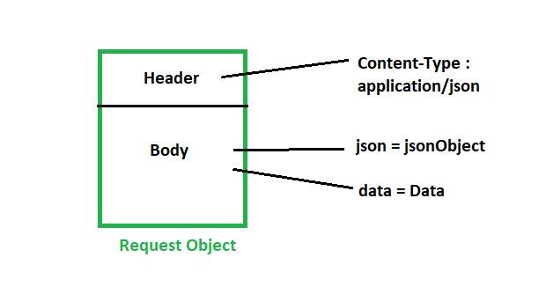
HTTP POST Request
5
POST /api/customers
//Build the Post Method
app.post('/api/customers',(req,res)=>{
//We are going to log our request
console.log(req.body);
//We build a const customer that is going to hold
//The id and the name
const customer = {
id: customers.length + 1,
name : req.body.name
}
//We are going to push the value of this customer into customers
customers.push(customer)
//Finally we are going to return the same value that we insert
return res.send(customer);
});
const express = require('express')
const app = express();
app.use(express.json())

Slide 21
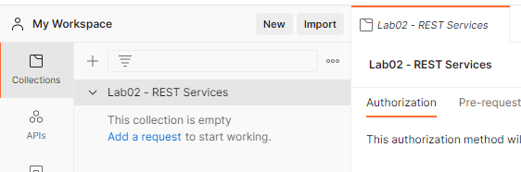
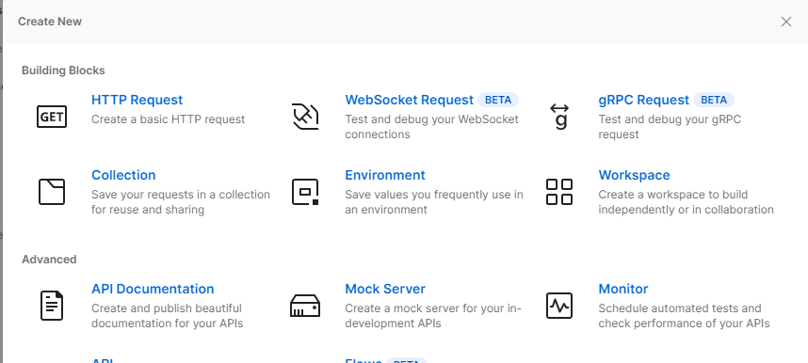
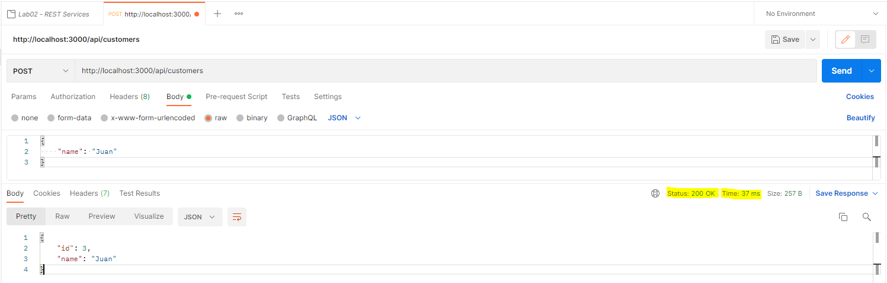
Calling Endpoints - Postman
6

Slide 22
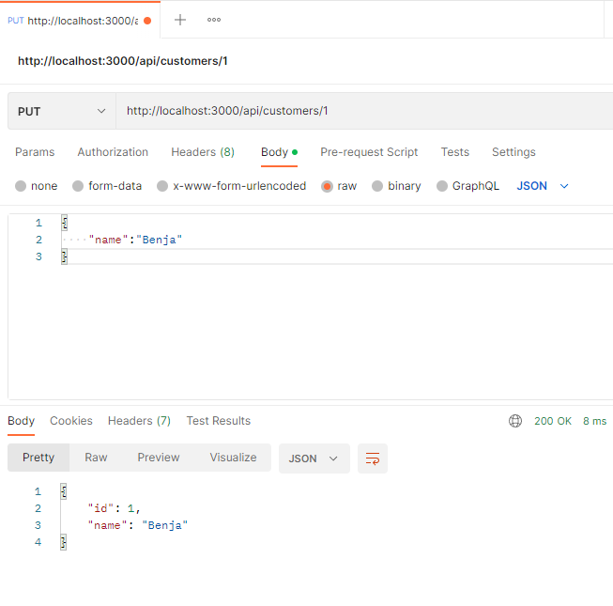
HTTP PUT Request
7
PUT /api/customers/1
//Build the Put Method with an identifier
app.get('/api/customers/:id',(req,res)=>{
//Look up for the customer as we do in the get method
const customer = customers.find(c => c.id === parseInt(req.params.id));
//IF the id is not found we're going to show a message
if(!customer){
res.status(404).send("The given ID doesn't belong to any customer");
}
//Validate that we're inserting the correct parameters / the name should be
//more than 3 characters long
if(!req.body.name || req.body.name.length <3){
res.status(400).send("Name is required and should be at least 3 characters long");
return;
}
//Update the customer
customer.name = req.body.name;
//return the updated results
res.send(customer);
});

Slide 23
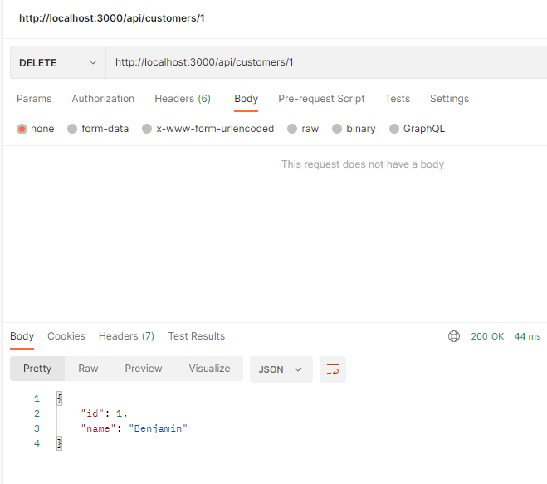
HTTP Delete Request
7
DELETE /api/customers/1
//Build the delete Method with an identifier
app.delete('/api/customers/:id',(req,res)=>{
//Look up for the customer as we do in the get method
const customer = customers.find(c => c.id === parseInt(req.params.id));
//IF the id is not found we're going to show a message
if(!customer){
res.status(404).send("The given ID doesn't belong to any customer");
}
//Delete the customer
const index = customers.indexOf(customer);
customers.splice(index,1);
//return the customer that was deleted
res.send(customer);
});

Slide 24

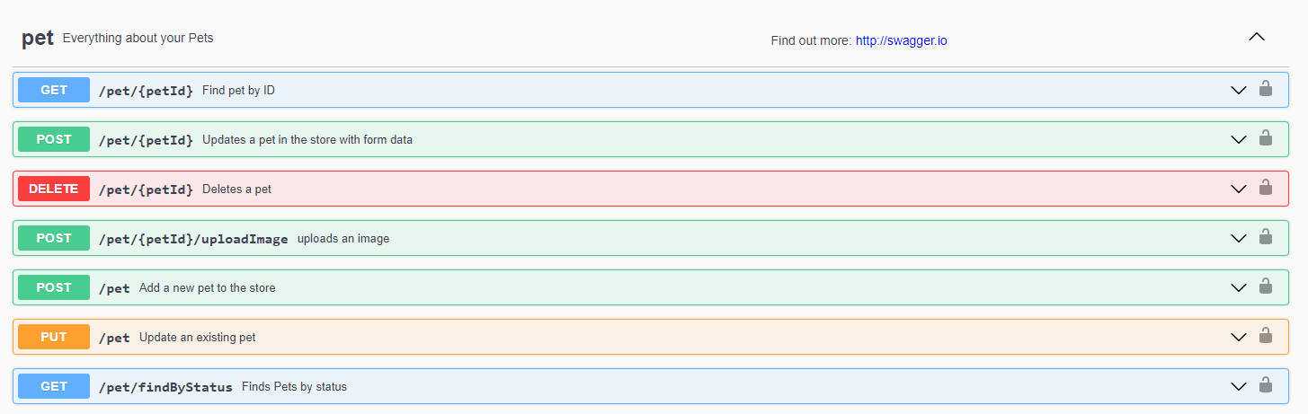
Swagger - Open API
Open Api defines a programming language-agnostic standard for RESTful API interfaces.

Slide 25
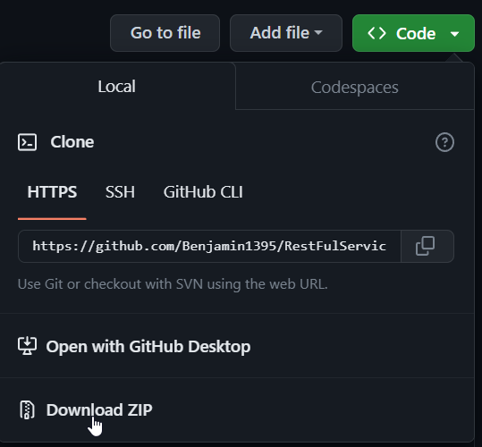

Artifacts
https://github.com/Benjamin1395/RestFulServicesLAB

